Slide 1


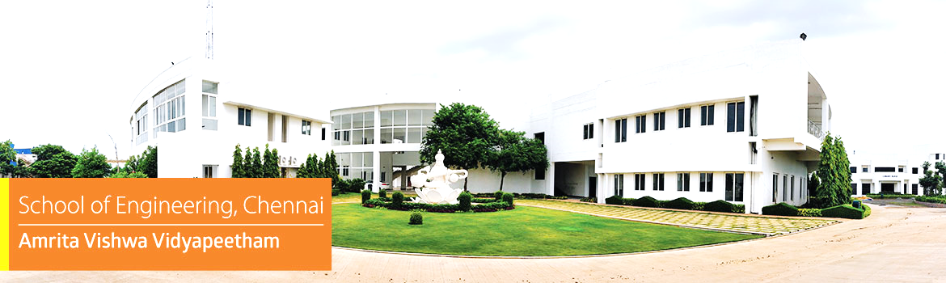


Embedded Systems Project
Ghost Vehicle in Fog Detector Using Pressure Wave Sensing Before Headlights Appear
Mentor :
Presented by :
Dr. C. Ganesh Kumar
Chairperson, Department of Electronics and Communication Engineering, School of Computing, Chennai
Akshaya M V - CH.EN.U4CCE24003
Devadharshini P - CH.EN.U4CCE24004
M Mukesh - CH.EN.U4CCE24015
1

Slide 2







Ghost Sense Initiative
The Edge-AI Solution
The Invisible Threat
Dense fog critically reduces visual range on highways and rural roads, rendering standard headlights ineffective.
Drivers face severely delayed detection of approaching vehicles, drastically increasing the likelihood of high-speed, catastrophic collisions.
A New Paradigm
The Technology Stack
Zero-Latency Intelligence
SENSE
PROCESS
WARN

Slide 3
Detecting approaching vehicles before they become visible by capturing the low-frequency pressure waves they push ahead of them.
Utilizes highly sensitive MEMS acoustic sensors. Processes physical data locally on a Cortex-M microcontroller.
Deploys TinyML and Edge-AI directly on the chip. Triggers life-saving early warnings without relying on:
SENSE
PROCESS
WARN
Capture invisible pressure disturbances generated by moving vehicles.
Trigger immediate driver alerts through:
Execute real-time signal analysis natively on a Cortex-M core.
Visual indicators (LEDs/Display) Audible alarms (Buzzer)

Slide 4












Architecture & Data Pipeline
Fromphysicalpressurewavestoreal-timeEdge-AI alerts.
Zone 1
Physical Sensing
Zone 2
Edge-AI Processing
Zone 3
Alert Execution
4. Data Acquisition
Vehicle Approaches
5. Digital Filtering
8. Confirmation
Acoustic Detection
6. Algorithmic Analysis
9. Early Warning
Signal Conditioning
7. Threshold Decision
10. Result
Pressure Waves > MEMS Sensor > Signal Conditioning > Cortex-M ADC > Digital Filtering > TinyML Analysis > Vehicle Detection > LED/LCD/Buzzer Alert > Driver Safety

Slide 5

Phase & Focus
Week
Core Activity
Literature Survey, Problem Analysis & Component Procurement.STM32/Cortex-M setup and architecture learning.
Key Milestone
Phase 1: Foundation(Research & Hardware)
Week 1-3
Hardware Procured & Environment Setup
Sensor Interfacing & ADC Testing.Data Collection from live moving vehicles.Initial Signal Processing Implementation.
Phase 2: Integration(Interfacing & Data)
Week 4 - 6
Successful Sensor Data Acquisition
Vehicle Detection Algorithm (TinyML) Development.LED, Buzzer, and Display Integration.System Testing, Calibration, and Optimisation.
Phase 3: Edge-AI(Algorithm & Alert)
Week 7 - 9
Functional Detection Algorithm
Complete Prototype Assembly.Result Analysis and Performance Evaluation.Report Writing and PPT Preparation.
Phase 4: Finalisation(Prototype & Delivery)
Week 10 - 12
Final Demonstration (Sept 20)

Slide 6





Hardware Ecosystem
Software Ecosystem
Compute
Output UI
Environment
Analysis Tools
STM32F401 / STM32F103 Cortex-M Microcontroller
OLED Display / LCD (16×2)
Warning LEDs
Buzzer
STM32CubeIDE STM32CubeMX
MATLAB
Python
Used for initial signal analysis and algorithm modeling
Sensing
Programming Language
MEMS Microphone Sensor
MAX9814 / MAX4466
Ancillary Components
Embedded C Programming Optimized for TinyML constraints
Simulation & Debugging
USB Programmer / ST-Link
Breadboard
Power Supply
Serial Terminal
Conditioning
PuTTY Tera Term
LM358 Operational Amplifier Used for signal amplification
Proteus (optional for simulation)
Expected Output
Early Detection : Reliable identification of approaching vehicles completely obscured by dense fog.
Immediate Alert : Distinct visual and audible warnings delivered to the driver via the edge device with zero latency.
Ultimate Impact : Significantly improved road safety and a drastic reduction in collisions under critical low-visibility conditions.

Slide 7

Thank You !

